Slide 1
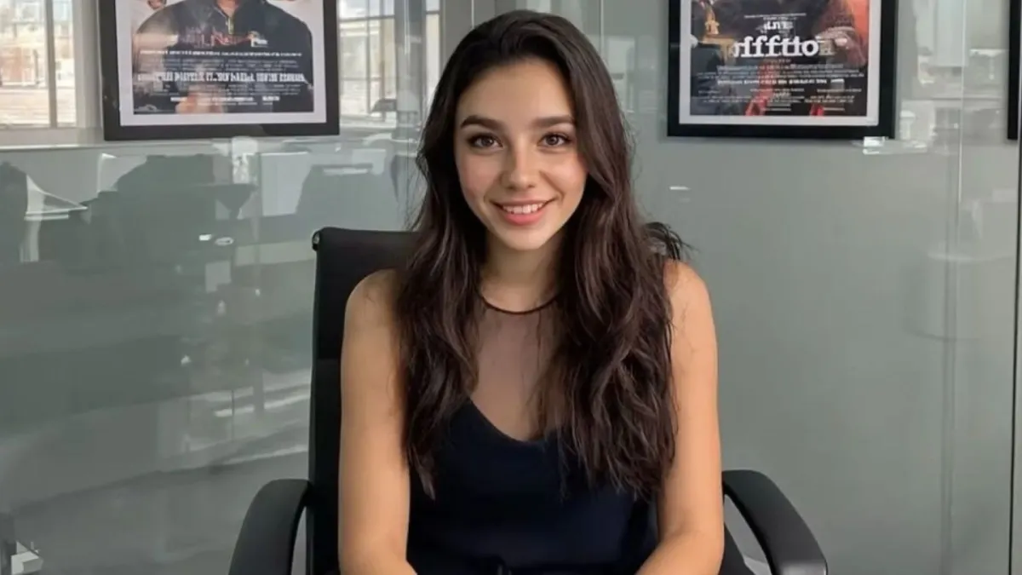
Can AI develop outside of a copyright licensing approach?
Eleonora Rosati
26 February 2026

Slide 2
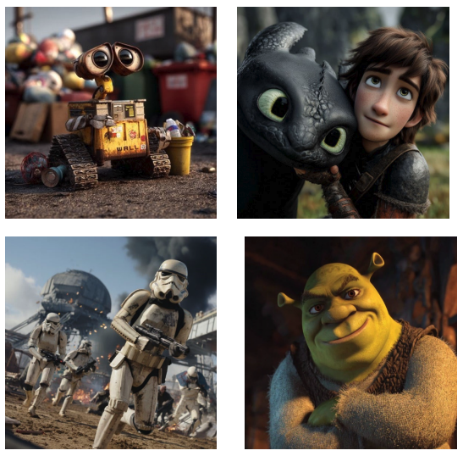
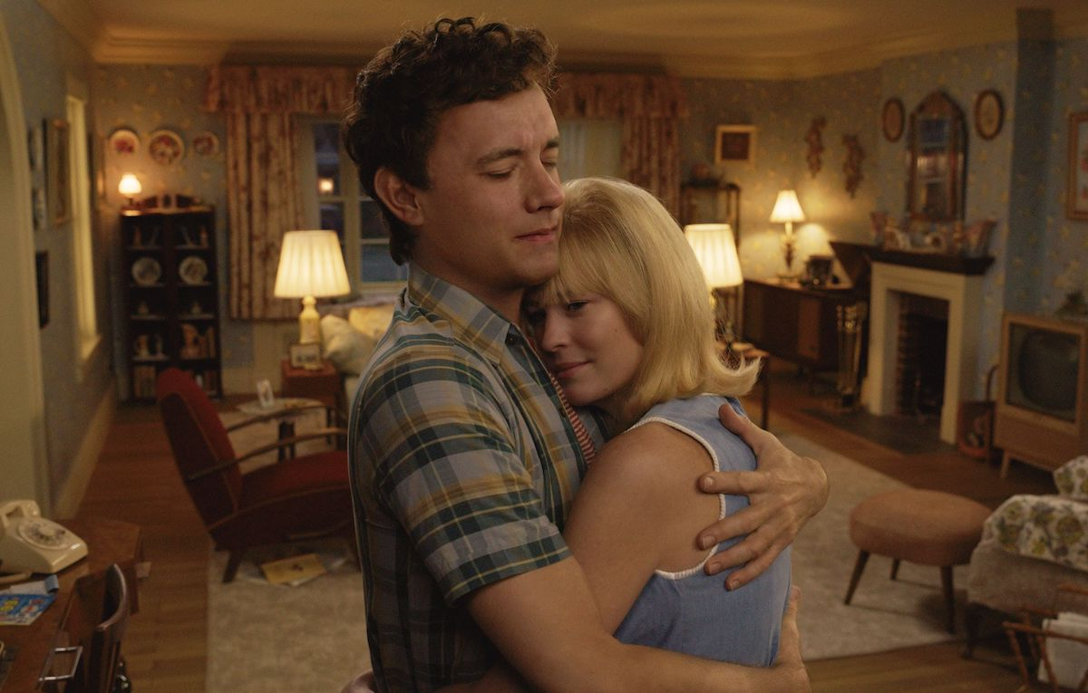
Examples of outputs generated by Midjourney
Younger versions of the characters played by Tom Hanks and Robin Wright in Here

Slide 3
Contents
Input/AI training: Licensing vs exceptions
Output generation: Liability considerations

Slide 4
Input/AI training: Licensing vs exceptions

Slide 5
Jurisdiction | Provision | Restrictions on beneficiaries? | Acts covered | Does the provision extend to output generation? | Purpose-specific | Express limitation to non-commercial use | Express requirement of lawful access | Express possibility of reservation | Reference to the three-step test
Japan | Art. 30-4 Copyright Act | No | Not specified | Not specified | Yes (non-enjoyment) | No | No | No | Yes
Singapore | Sec. 244 Copyright Act 2021 | No | Reproduction | No | Yes (computational data analysis) | No | Yes | No | No
UK | Sec. 29A CDPA | No | Reproduction | No | Yes (research) | Yes | Yes | No | No
EU | Art. 3 DSMD | Yes (research organizations and cultural heritage institutions) | Extraction and reproduction | No | Yes (scientific research) | No | Yes | No | Yes (Art. 7 DSMD)
EU | Art. 4 DSMD | No | Extraction and reproduction | No | No | No | Yes | Yes | Yes (Art. 7 DSMD)
(USA) | Section 107 US Copyright Act | No | TBC | TBC | No | No | No | No | No

Slide 6
Examples of outputs generated by Midjourney (source: Case 2:25-cv-05275)

Slide 7
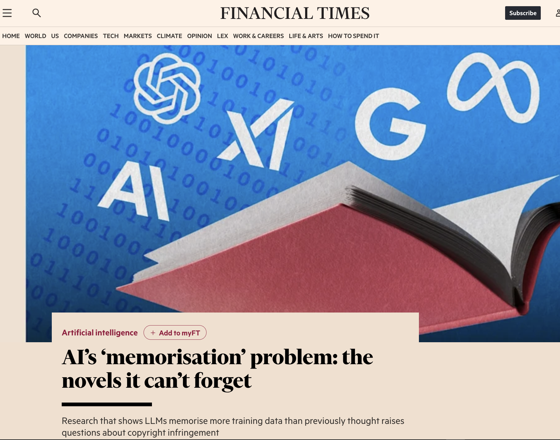

Slide 8
Scraping/crawling of protected content online
Sui generis database right (if content included in database)
Creation of dataset
Right of reproduction
Online publication of dataset
Right of reproduction
Right of reproduction
Right of communication/making available to the public
Downloading of dataset
AI training
Use of resulting model
Right of reproduction
Sui generis database right
Right of reproduction
Right of communication/making available to the public
Right of distribution
Right of adaptation
Right of reproduction
TDM not synonymous with AI training
Other considerations
The ‘false’ myth of memorization
Lawful access
Three-step test
Displacement (also in USA)
UK fair dealing

Slide 9
Output generation: Liability considerations

Slide 10
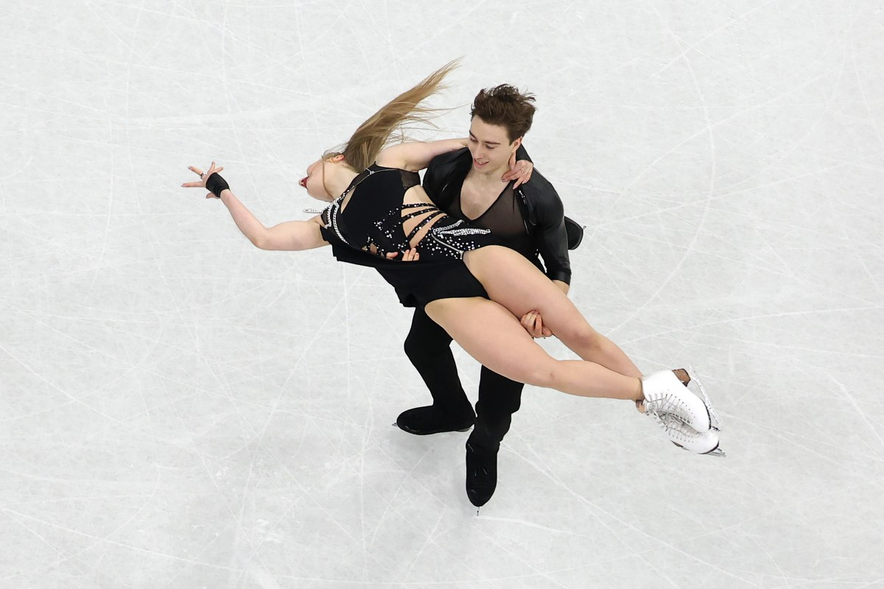
Who would need a licence?
User
AI model developer
AI model provider
Primary / secondary liability
Contractual considerations
Exceptions / limitations

Slide 11
Where do we go from here?
Opportunities, threats, displacement
Licensing vs exceptions
Style protection and liability considerations
Transparency
Would the introduction of a presumption of use help? But would it be allowed at the EU level?

Slide 12
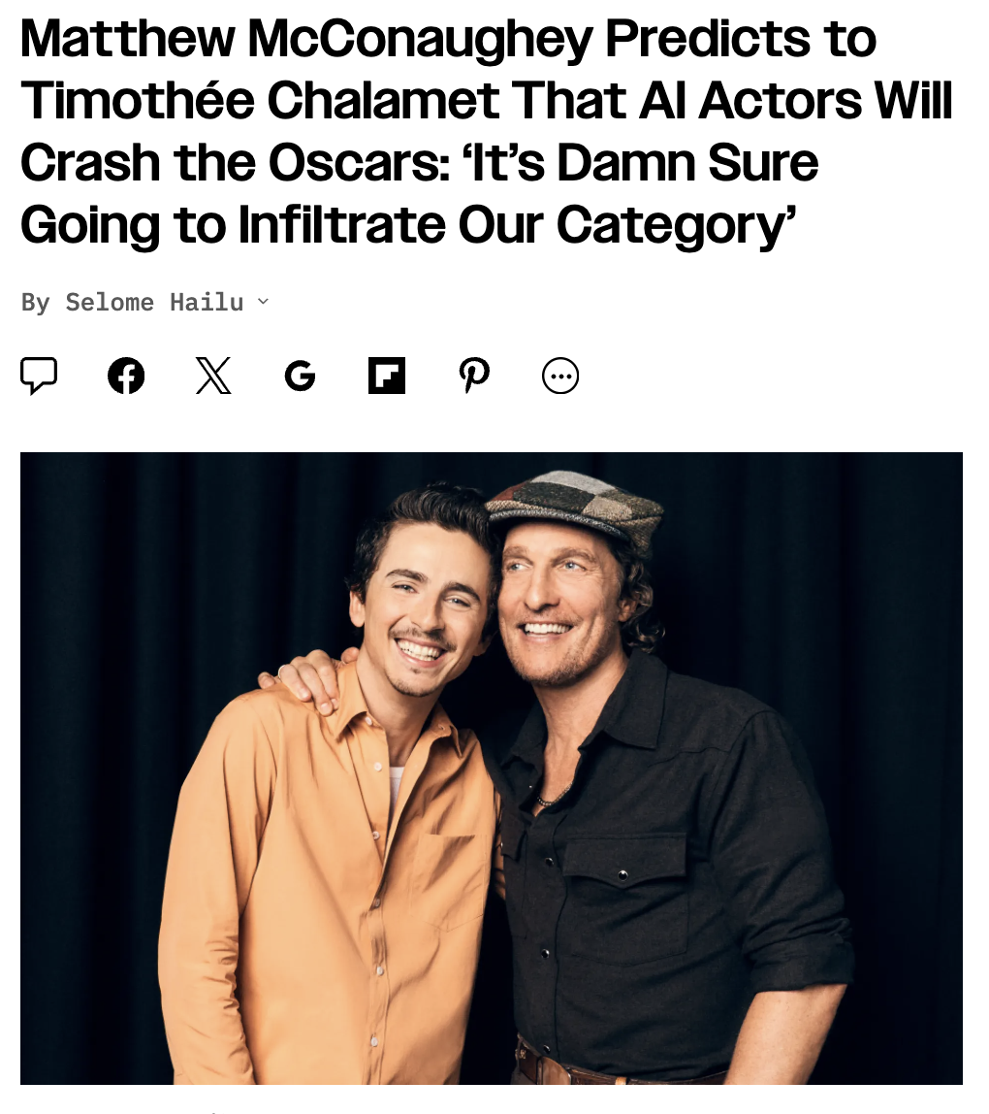
Thanks for your attention!
https://www.linkedin.com/in/eleonorarosati/
eleonora@elawnora.com

